Slide 1
Campus: Log-in with Institutional Email Domain

Slide 2
Guide for first log-in
Step 2a
Log in via new MyKarger account
Step 1
Go to Campus
Step 3
Access courses
Step 2b
Log in via existing MyKarger account

Slide 3
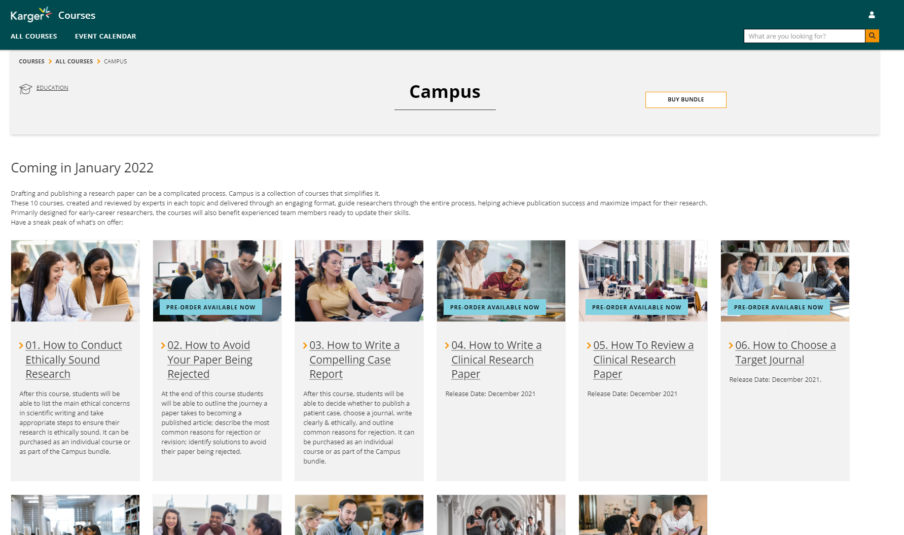
Step 1
Go to www.karger.com/campus and click ‘buy bundle’

Slide 4
Guide for first log-in
Step 2a
Log in via new MyKarger account
Step 1
Go to campus
Step 3
Access courses
Step 2b
Log in via existing MyKarger account

Slide 5
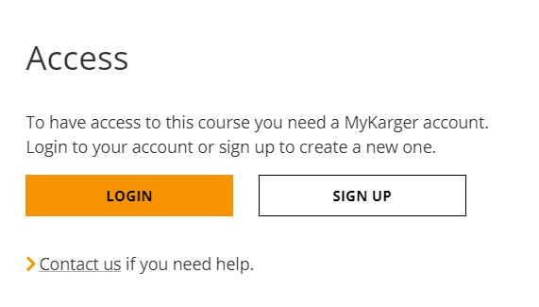
Step 2a
Create a MyKarger account by clicking ‘sign up’

Slide 6
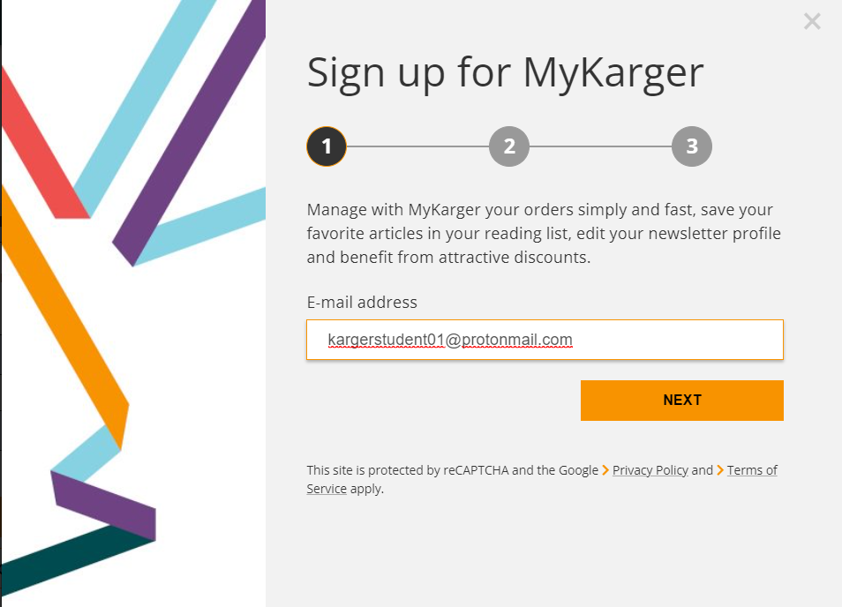
Step 2a
Enter your email address
Important:
Sign up with your institutional email domain (e.g. @unibasel)

Slide 7
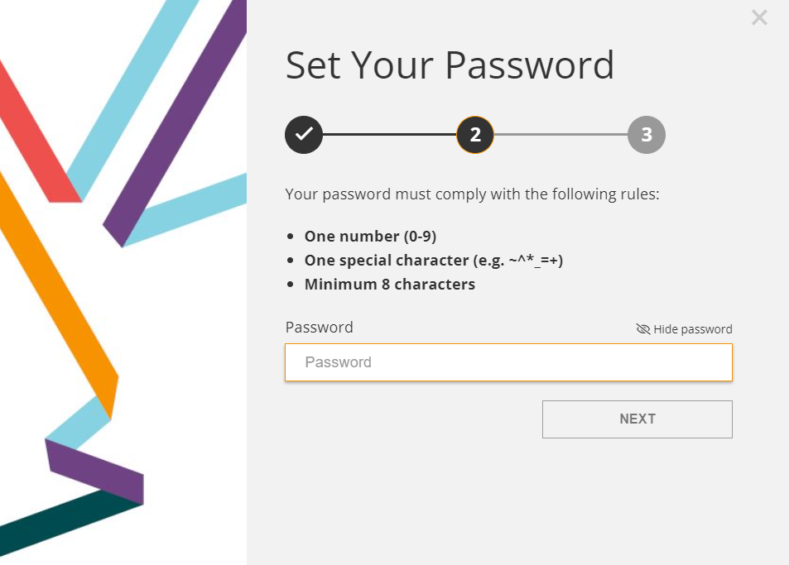
Step 2a
Choose a password

Slide 8
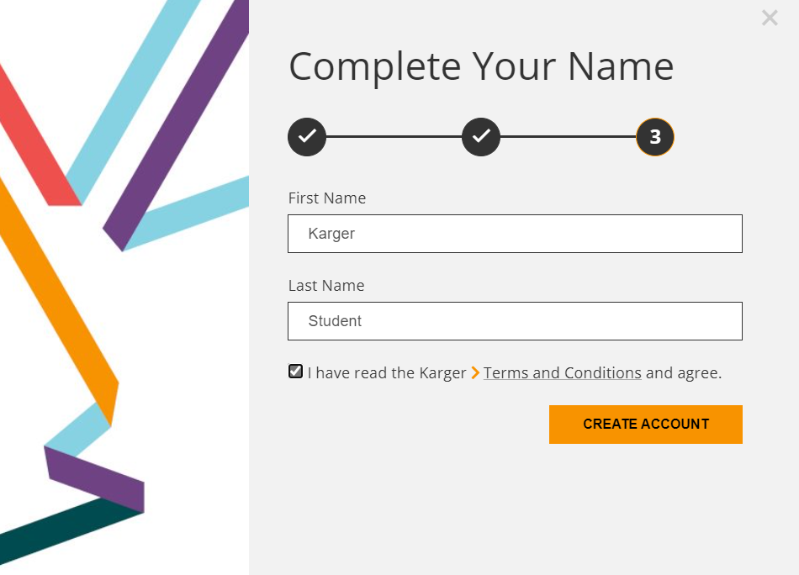
Step 2a
Enter your name and agree to the ‘terms and conditions’

Slide 9
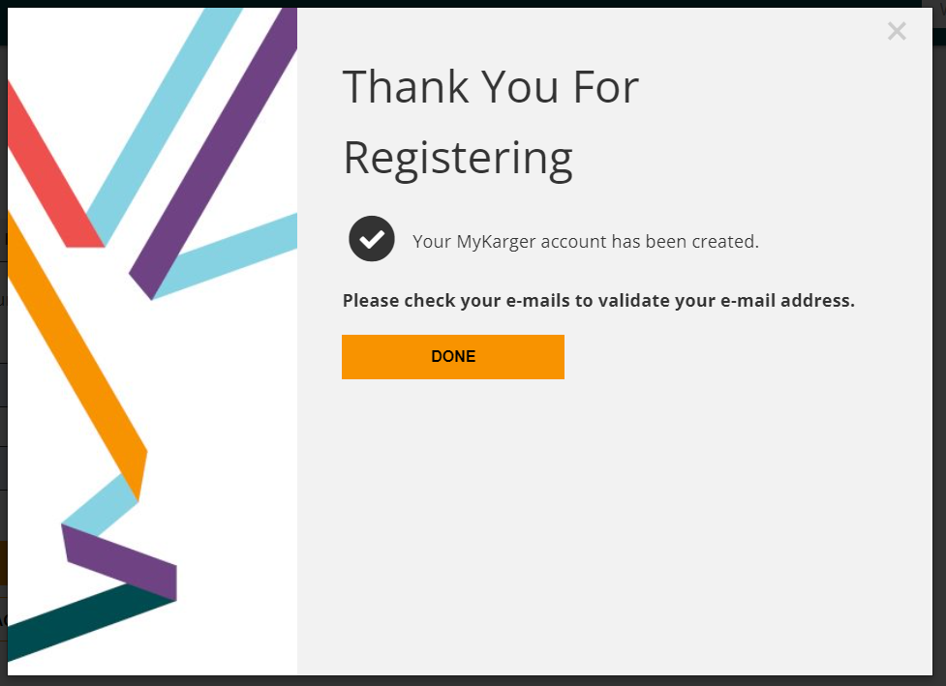
Step 2a
Click ‘done’

Slide 10
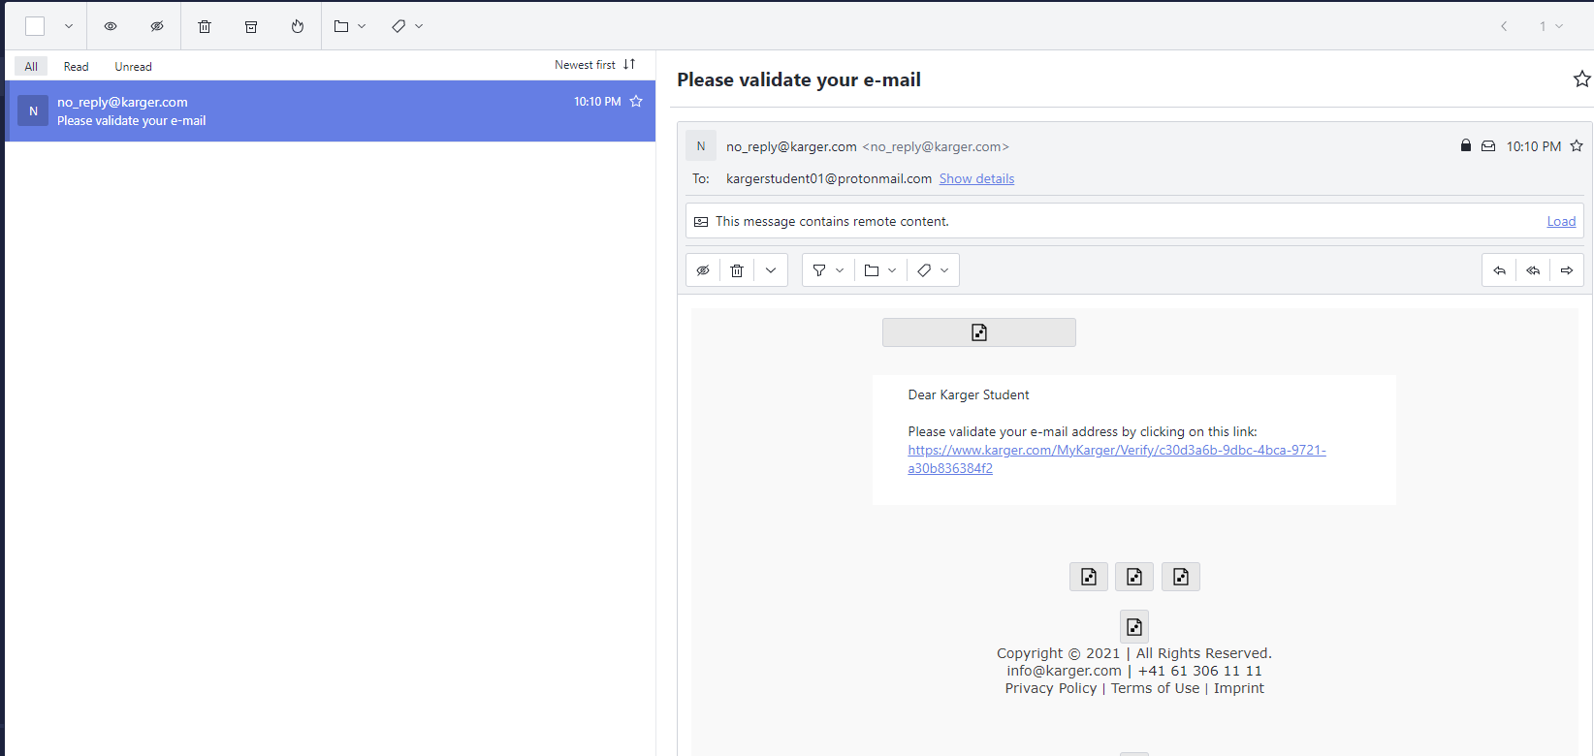
Step 2a
Click on link in email sent to your email address to validate

Slide 11
Guide for first log-in
Step 2a
Log in via new MyKarger account
Step 1
Go to Campus
Step 3
Access courses
Step 2b
Log in via existing MyKarger account

Slide 12
Step 2b
Go to www.karger.com/campus and log-in via existing MyKarger account

Slide 13
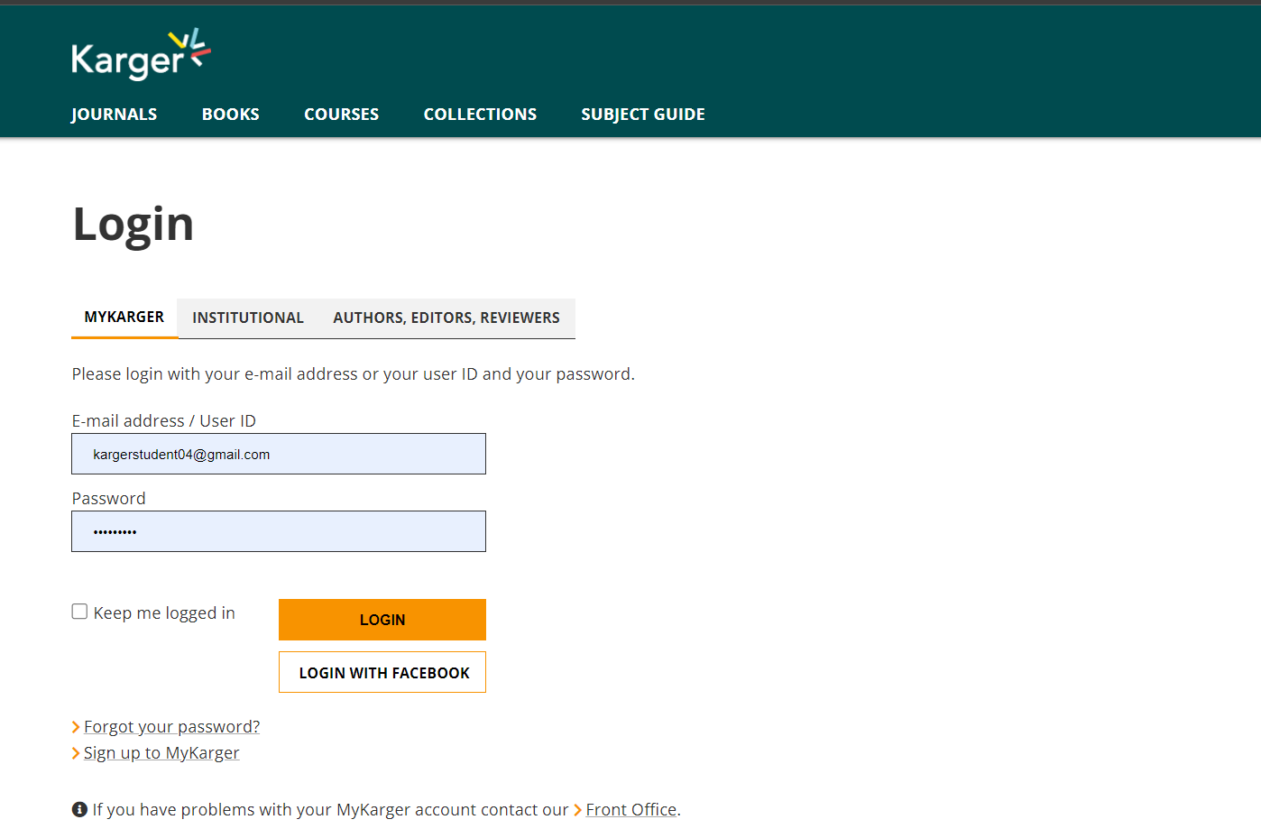
Step 2b
Enter your MyKarger log-in details

Slide 14
Guide for first log-in
Step 2a
Log in via new MyKarger account
Step 1
Go to Campus
Step 3
Access courses
Step 2b
Log in via existing MyKarger account

Slide 15
Step 3
Access to all Campus courses on dashboard

Slide 16
If you have any log-in or access issues please contact us for assistance.

